Slide 1

Recent results from Belle
Denis Epifanov
The University of Tokyo
on behalf of Belle collaboration
Outline:
Study of bottomonia and exotic Z_{b}±
Search for New Physics in B → D^{(*)} τ ν
Search for dark photon and dark Higgs

Slide 2
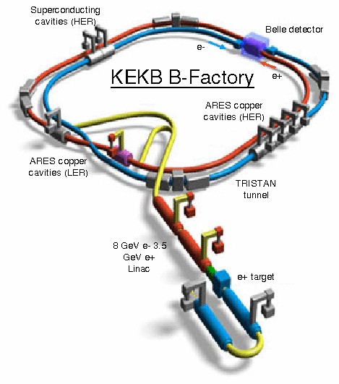
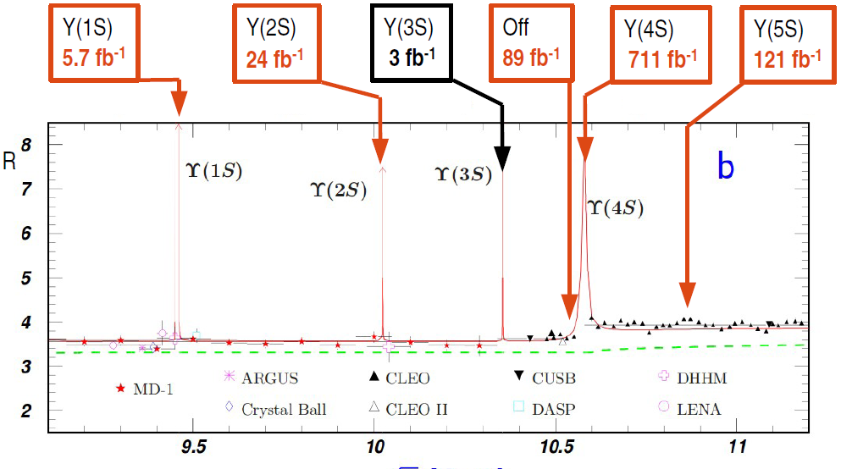
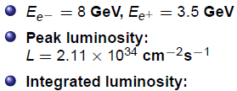
Belle experiment

Slide 3
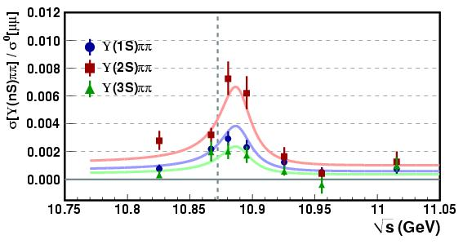
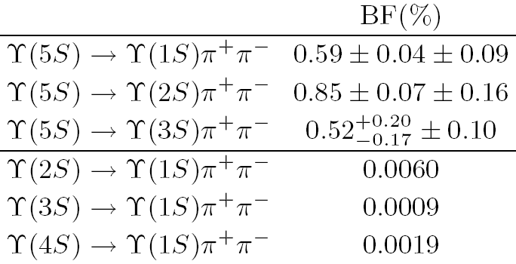
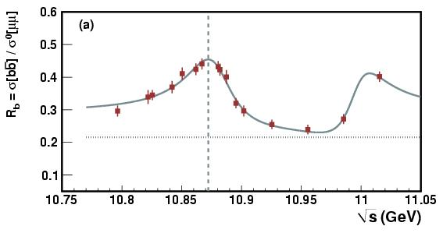
Study of σ(e⁺e⁻→ϒ(nS)π⁺π⁻) and σ(e⁺e⁻→ ) in the region of ϒ(5S) and ϒ(6S) resonances
Anomalous ϒ(5S)→ ϒ(nS)π⁺π⁻ rates were previously observed at Belle.
R_{ϒππ}= σ(e⁺e⁻→ϒ(nS)π⁺π⁻)/σ_{μμ} and R_{b}= σ(e⁺e⁻→ )/σ_{μμ} were measured in the region of ϒ(5S) and ϒ(6S). Mass and width of ϒ(5S) were measured precisely.
PRL100,112001(2008)
Γ(MeV)
PRD82,091106R(2010)
∆M = (9 ± 4) MeV/c²
10²
Rescattering ϒ(5S)→BBππ→ϒ(nS)ππ
Exotic resonance Y_{b} near ϒ(5S) analogue of Y(4260) resonance with anomalous Γ(J/ψ π⁺π⁻)
Tetraquarks
Simonov JETP Lett 87,147(2008);
Meng et al. Phys.Rev.D78:034022,2008
Hou et al., Phys.Rev.D74:017504,2006
Ali et al. Phys.Rev.Lett.104:162001,2010
9×30 pb⁻¹
Karliner et al. arXiv:0802.0649v2;
N. Brambilla et al, Eur.Phys.J. C71 (2011) 1534

Slide 4



Study of σ(e⁺e⁻→ϒ(nS)π⁺π⁻) and σ(e⁺e⁻→ ) in the region of ϒ(5S) and ϒ(6S) resonances
hep-ex :1501.01137
Data: 61 points / 50 pb⁻¹; 5 MeV step
R_{b}
Selections: ≥5 IP tracks, ≥2 ECL clusters )
ECL energy: (0.1−0.8) √s, total energy > 0.5√s
Efficiency: (70−74)%
large int. with
continuum
subtracted
from cont. point (10.52 GeV)
rad. return
to ϒ(1÷3S)
R_{b}: w/ rad. return to ϒ(1÷3S)
Fit of R_{b}/R’_{b}:
R’_{b}: w/o rad. return to ϒ(1÷3S)
R_{b}
R’_{b}
Uncontrollable systematic error of the resonance masses and widths
due to large contribution from continuum with unknown shape

Slide 5
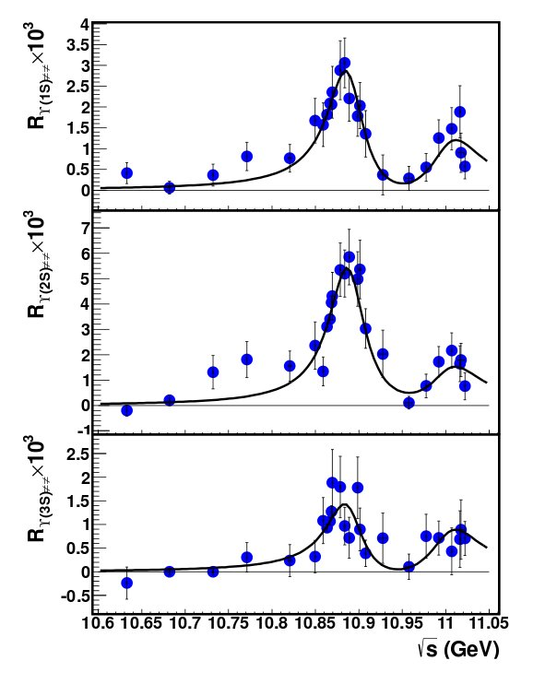






Study of σ(e⁺e⁻→ϒ(nS)π⁺π⁻) and σ(e⁺e⁻→ ) in the region of ϒ(5S) and ϒ(6S) resonances
Data: (16+6 ) points / 1 fb⁻¹
hep-ex :1501.01137
Full reconstruction of ϒ(nS)[→μ⁺μ⁻]π⁺π⁻
R_{ϒππ}
Efficiency: (15 ÷ 45)%
Fit of R_{ϒππ}:
A_{nr}, A_{r} consistent with zero, fixed at zero
∆M=(9.3 ± 3.9) MeV/c²
∆M=(15.5±11.1) MeV/c²
No significant difference in ϒ(5S) parameters between R_{b} and R_{ϒππ}
R_{ϒππ} is preferable for measuring masses and widths of ϒ(5S,6S)

Slide 6

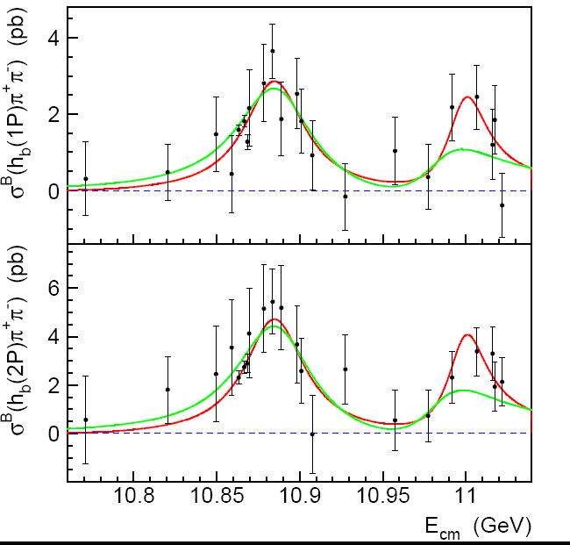


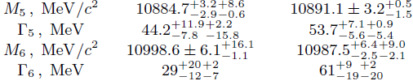
Study of σ(e⁺e⁻→h_{b}(nP)π⁺π⁻) (n=1,2) in the region of
ϒ(5S) and ϒ(6S) resonances
Data: 121.4 fb⁻¹ @ϒ(5S) +19 points /1 fb⁻¹
h_{b}(1P)π⁺π⁻
Selections: inclusive reconstruction in
ϒ(2S)π⁺π⁻
fit of h_{b}(nP) signals in M_{miss}(π⁺π⁻)
Cross section:
(ISR corr.)
Belle PRELIMINARY
h_{b}(2P)π⁺π⁻
Fit of σ^{B}(e⁺e⁻→h_{b}(nP)π⁺π⁻):
phase space factor takes into account dynamics with Z_{b} states
Non-resonant continuum contribution is consistent with zero
ϒ(5S) and ϒ(6S) parameters agree with those measured in σ(e⁺e⁻→ϒ(nS)π⁺π⁻)

Slide 7
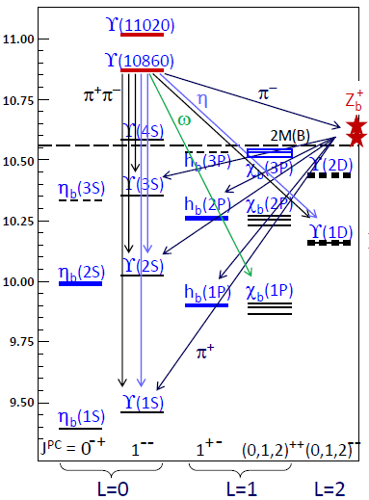

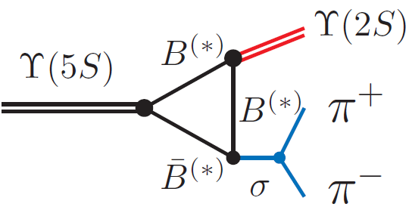
Anomalies in ϒ(5S)→ π⁺π– transitions
Belle: PRL100, 112001 (2008)
Γ(ϒ(5S)→ϒ(1S/2S/3S)π⁺π⁻) = 260/430/290 keV
Belle: PRL108, 032001 (2012)
Γ(ϒ(5S)→h_{b}(1P/2P)π⁺π⁻) = 190/330 keV
ϒ(5S)→h_{b}(1P/2P)π⁺π⁻ are not suppressed,
although expect suppression ∼Λ_{QCD}/m_{b} due to
spin-flip
_
Rescattering of on-shell B^{(*)}B^{(*)} ?
Study dynamics of ϒ(5S)→ π⁺π– transitions:
Belle: PRL108, 032001 (2012)
Two charged bottomoniumlike resonances, Z_{b}(10610) and Z_{b}(10650), were
observed in five decay channels, ϒ(nS)π± (n = 1, 2, 3) and h_{b}(mP)π± (m = 1, 2)

Slide 8
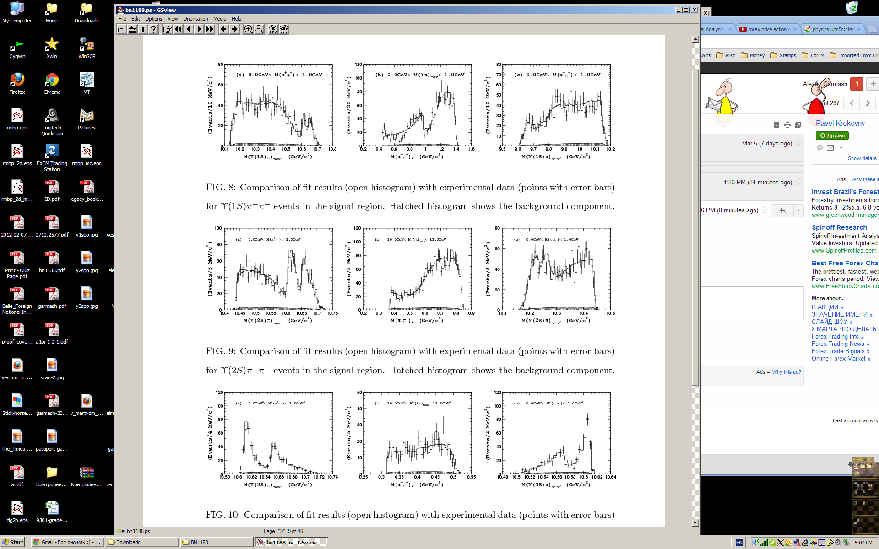
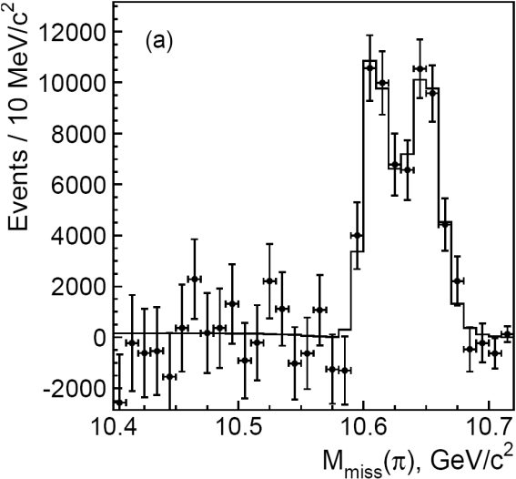
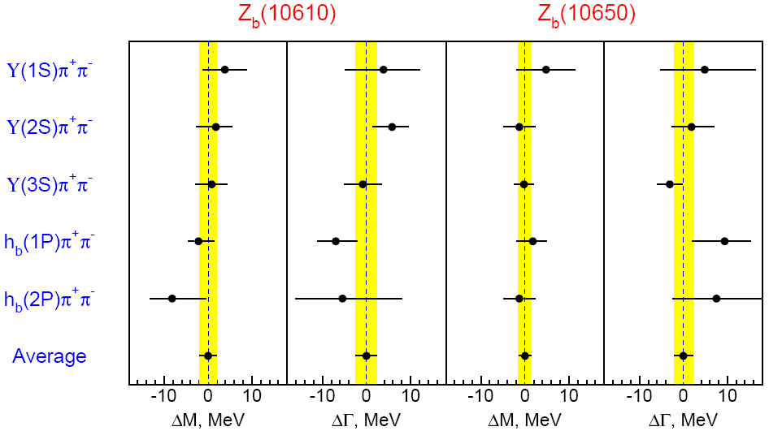
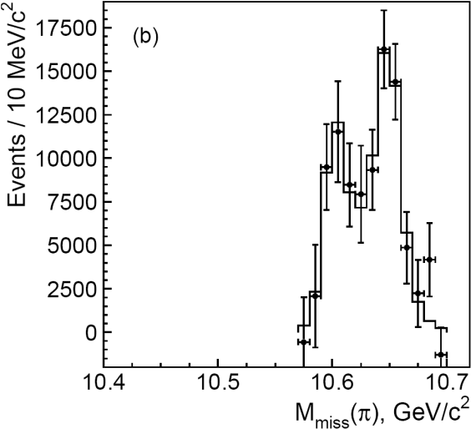
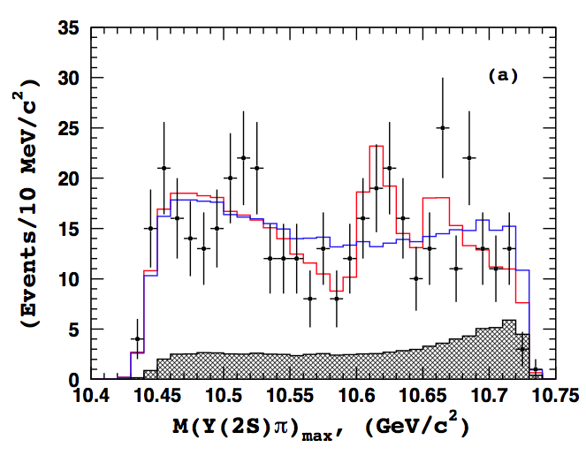
Study of ϒ(5S)→Z_{b}π
Similar production rates of Z_{b}(10610) and Z_{b}(10650) in five decay channels
ϒ(1S)π⁺π⁻
ϒ(2S)π⁺π⁻
ϒ(3S)π⁺π⁻
h_{b}(1P)π⁺π⁻
Average over 5 channels
Averages for Z_{b}±:
⟨ M₁ ⟩ = 10607.2±2.0 MeV
h_{b}(2P)π⁺π⁻
⟨ Γ₁ ⟩ = 18.4±2.4 MeV
⟨ M₂ ⟩ = 10652.2±1.5 MeV
⟨ Γ₂ ⟩ = 11.5 ± 2.2 MeV
Belle: PRD 88, 052016 (2013)
ϒ(2S)π⁰π⁰
M_{miss}(π), GeV/c²
M₁-M_{B}-M_{B*} = (2.4 ⁺ 2.1) MeV/c²
M₂-M_{B*}-M_{B*} = (1.8 ⁺ 1.8) MeV/c²
Z_{b}⁰ Results:
⟨ M₁ ⟩ = 10609±7±6 MeV
consistent with Z_{b}±

Slide 9
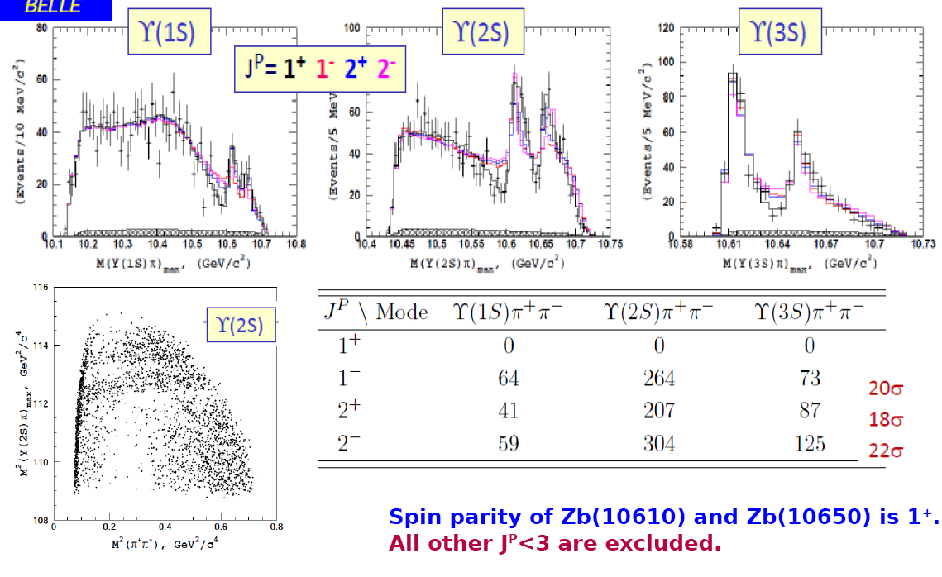
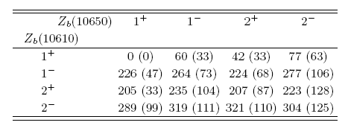
Amplitude analysis of e⁺e⁻→ϒ(nS)π⁺π⁻
Belle: PRD91, 072003 (2015)
L_{fit}-L_{nominal} for ϒ(2S)π⁺π⁻ (ϒ(3S)π⁺π⁻)

Slide 10
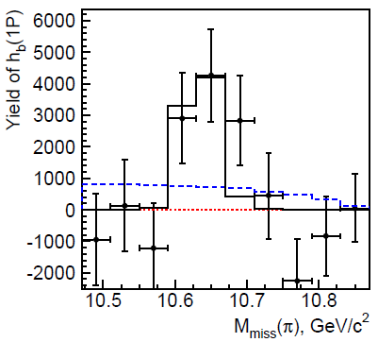
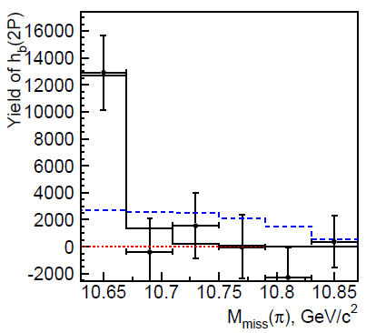
Evidence of ϒ(6S)→Z_{b}[→h_{b}π]π
3.4σ
4.7σ
M_{miss}(π⁺π⁻) was fitted in bins of M_{miss}(π)
With present statistics we cannot conclude if both Z_{b}(10610) and Z_{b}(10650) states are produced at ϒ(6S), or only one of them.

Slide 11
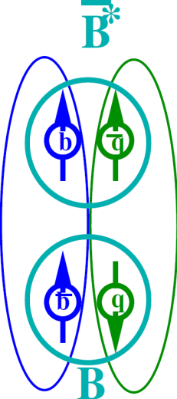
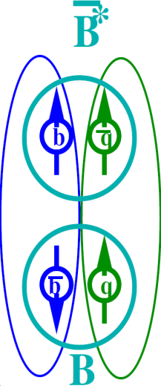
Heavy quark spin structure in Z_{b}
A.B.,A.Garmash,A.Milstein,R.Mizuk,M.Voloshin PRD84 054010 (arXiv:1105.4473)
Wave function at large distance – molecule B(*)B*:
Explains:
Why h_{b}ππ is unsuppressed relative to ϒππ
Relative phase ~0 for ϒ and ~180⁰ for h_{b}
Production rates of Z_{b}(10610) and Z_{b}(10650) are similar
Widths of Z_{b}(10610) and Z_{b}(10650) are similar
Dominant decays to B(*)B*
Other Possible Explanations
Coupled channel resonances (I.V.Danilkin et al, arXiv:1106.1552)
Cusp (D.Bugg Europhys.Lett.96 (2011),arXiv:1105.5492)
Tetraquark (M.Karliner, H.Lipkin, arXiv:0802.0649)
Notes:
11

Slide 12
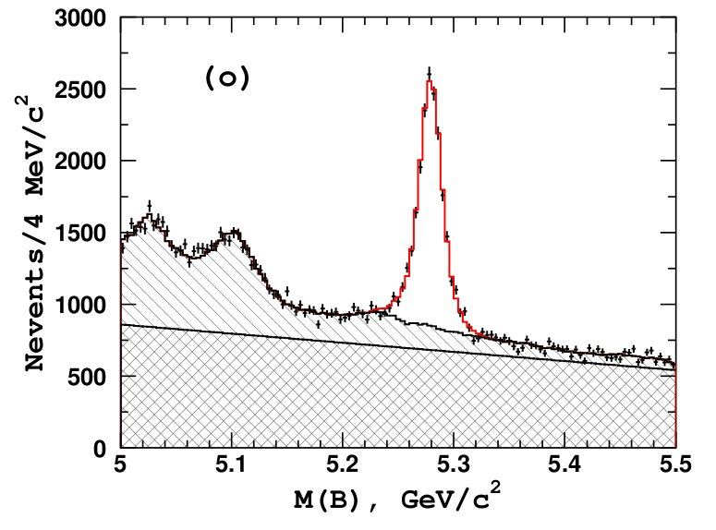
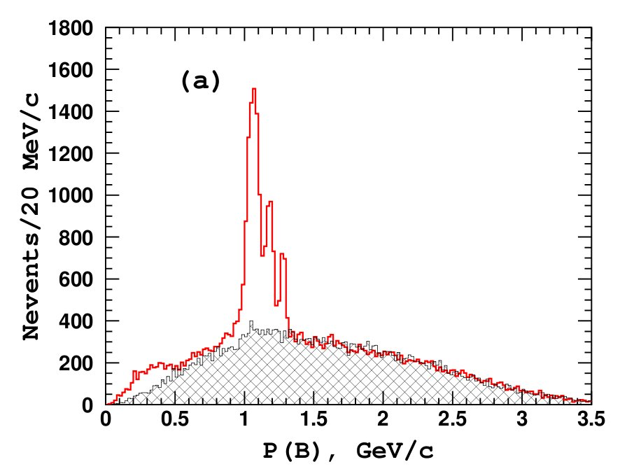
Study of e⁺e⁻→B^{(*)}B^{(*)}π at ϒ(5S)
Masses of the observed Z_{b} resonances are close to the BB* and B*B* thresholds, respectively: branching fractions Z_{b} →B(*)B* might be large (dominant).
Analysis strategy:
–
Full reconstruction of one B meson in eighteen modes: B⁺→J/ψ K^{(*)+}, D^{(*)0}π⁺;
B⁰→J/ψK^{(*)0}, D^{(*)-}π⁺
B
π
e+
e-
B*
18 B decay modes combined
_
B background
B*B*
B Signal
B signal
_
BB*
12263±168
_
BB
B sidebands
qq background
B⁽*⁾B⁽*⁾π + BBγ

Slide 13
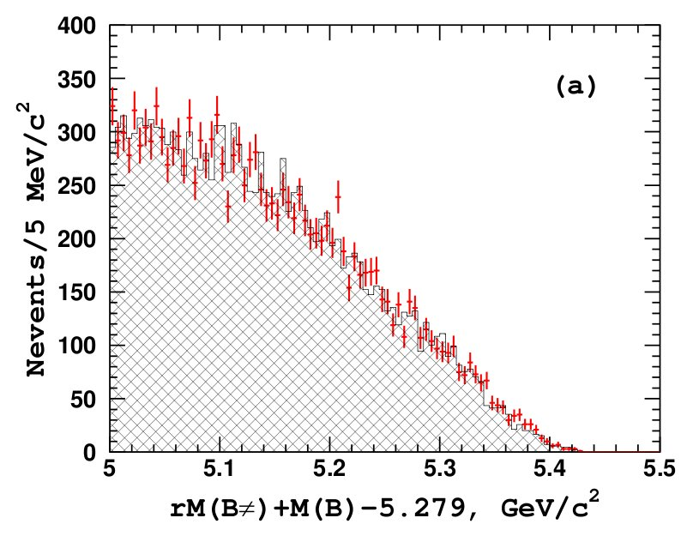

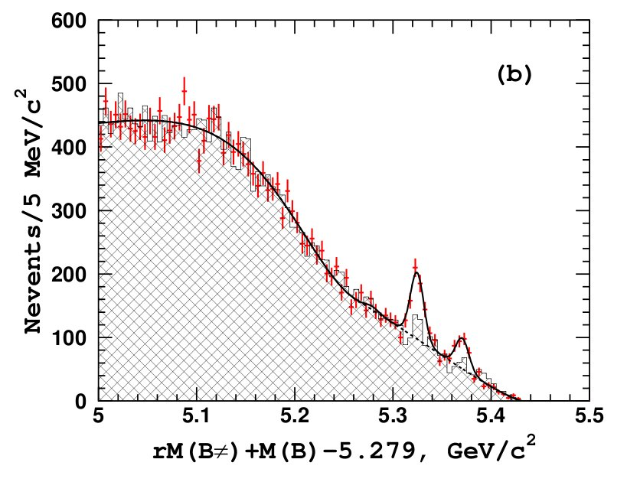
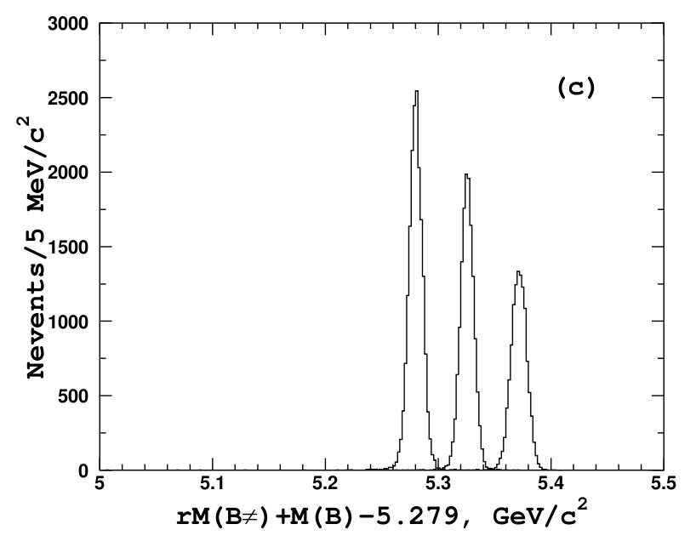

Study of e⁺e⁻→B^{(*)}B^{(*)}π at ϒ(5S)
Analysis strategy:
Data:
M(B) sidebands
Combine a B candidate with a charged pion from the rest of the event → calculate recoil mass against the Bπ system
RS data
WS data
BB threshold
RS data
rM(Bπ), GeV/c²
WS data
Fit
B*B π
B⁽*⁾B⁽*⁾π
signal MC
B*B*π
rM(Bπ), GeV/c²
rM(Bπ), GeV/c²
N(BBπ ) = 13 ± 25
σ(e⁺e⁻→BBπ )
σ(e⁺e⁻→BB*π )
N(BB*π ) = 357 ± 30
σ(e⁺e⁻→ B*B*π )
were measured
N(B*B*π ) = 161 ± 21

Slide 14
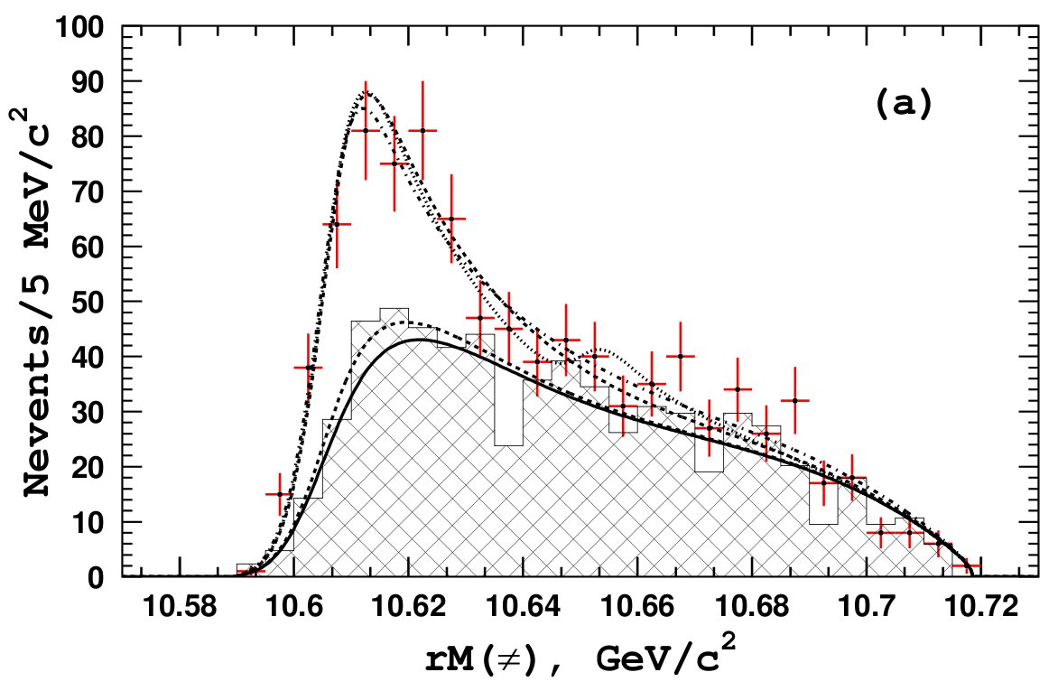
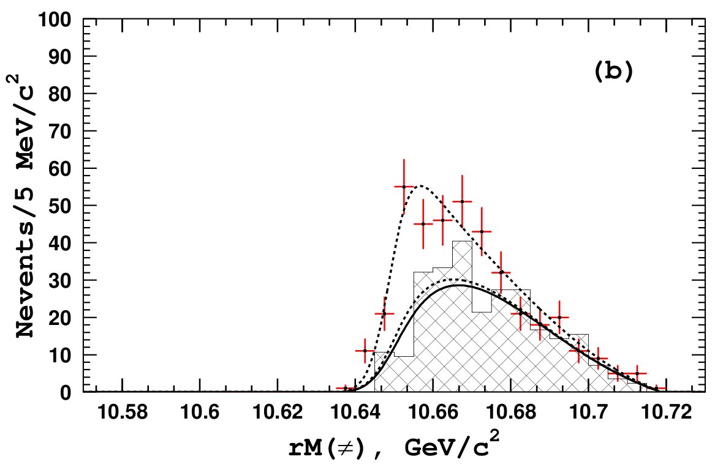
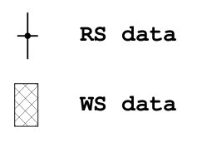
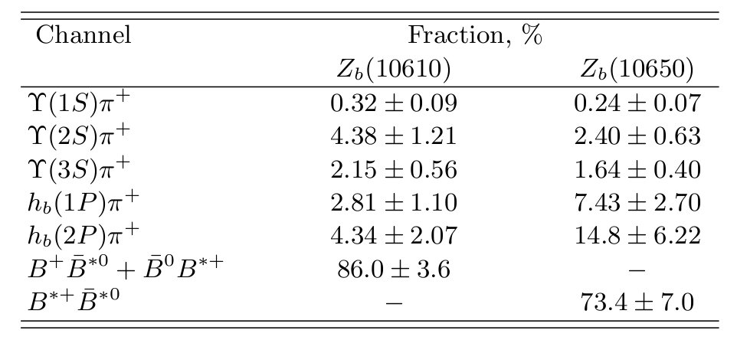
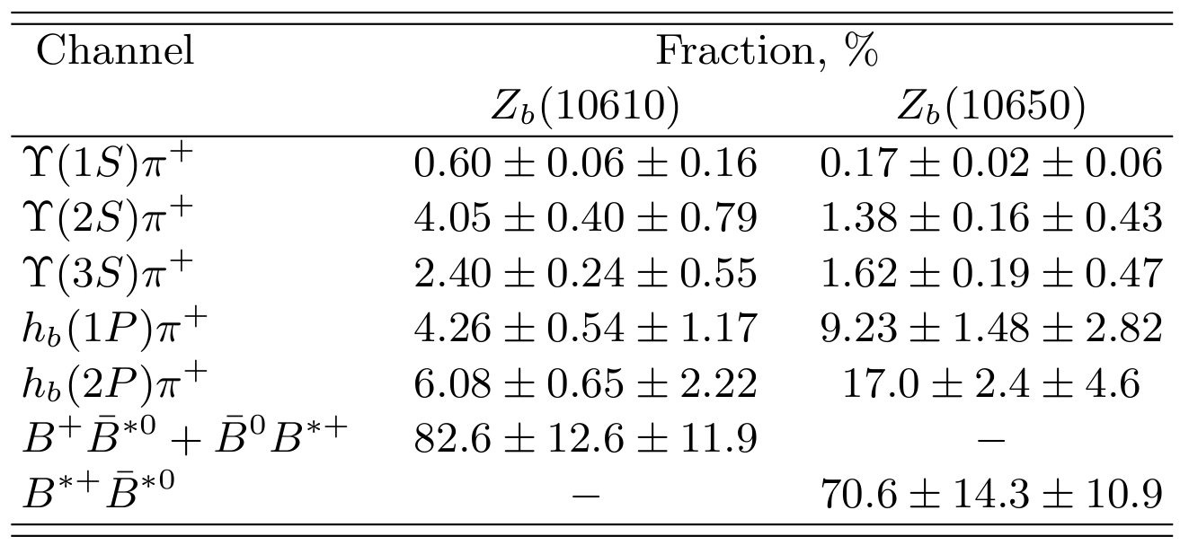
Study of e⁺e⁻→B^{(*)}B^{(*)}π at ϒ(5S)
Analysis strategy:
For events from 3-body sig. region → recoil mass against primary π±
BB*π
background
B*B*π
Z_{b}(10610) only
9.3σ
Z_{b}(10610) + NR
8.1σ
Z_{b}(10610) + Z_{b}(10650)
background
Z_{b}(10650) only
rM(π), GeV/c²
rM(π), GeV/c²
BB*π and B*B*π data fits well to just Z_{b}(10610) and Z_{b}(10650) signal, respectively
Assuming Z_{b} decays are saturated by already observed channels
B⁽*⁾B* channels dominate the Z_{b} decays

Slide 15
Summary on Z_{b}(10610) and Z_{b}(10650)
Z_{b} are very close to BB* and B*B* thresholds
Their quantum numbers are: I^{G},J^{PC} = 1⁺,1⁺⁽⁻⁾
They are observed both in the hidden-bottom modes (ϒ(1S/2S/3S)π and h_{b}(1P/2P)π) and in the open-bottom modes (BB*, B*B*) at ϒ(5S) resonance
We found an evidence of Z_{b}(10610) and Z_{b}(10650) states in decays ϒ(6S)→Z_{b}[→h_{b}(1P/2P)π]π
BB*/B*B* modes dominate in Z_{b} decays with the branching ratios 83%/71%
Energy behaviour of σ(e⁺e⁻→ϒ(nS)π⁺π⁻) and σ(e⁺e⁻→h_{b}(nP)π⁺π⁻) are similar
Z_{b} properties agree well with B^{(*)}B* molecular structure

Slide 16
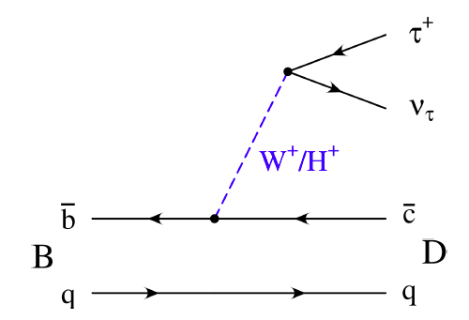
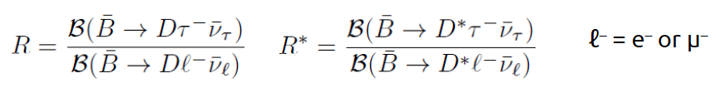
Search for New Physics in B→D^{(*)}τν
Process with third generation quarks and leptons
In models with charged Higgs bosons their couplings are
proportional to lepton mass, hence NP effects are enhanced for τ
New physics could change:
Branching fraction
Tau polarization
Effect could be different for D and D*
Confirm BaBar result: PRL 109 101802 (2012), PRD 88 072012 (2013)
Experimental challenge: 2 (hadronic τ decay) or
3 (leptonic τ decay) undetected neutrinos

Slide 17
Search for New Physics in B→D^{(*)}τν
arXiv: 1507.03233
Statistics: 772 × 10⁶ BB pairs
Selections:
B_{tag} is reconstructed using hadronic full reconstruction algorithm, which
includes 1149 B final states (rec. efficiency 0.3% for B⁺ and 0.2% for B⁰).
Additional requirements on the purity of B_{tag} sample preserves ≈85% of
signal B→D^{(*)}τν decays
τ is reconstructed in the leptonic decays τ→eνν, μνν, so the signal and
normalization modes have the same final particles → reduces systematic uncertainty of R^{(*)}
In the events with B_{tag} we select D^{(*)}ℓ (D⁺ℓ⁻, D⁰ℓ⁻, D^{*+}ℓ⁻, D^{*0}ℓ⁻), ℓ = e or μ
among remaining tracks and clusters:
D⁺→K⁻π⁺π⁺, K⁰_{S}π⁺, K⁰_{S}π⁺π⁰, K⁰_{S}π⁺π⁺π⁻; D^{*+}→D⁰π⁺, D⁺π⁰;
D⁰→K⁻π⁺, K⁻π⁺π⁺π⁻, K⁻π⁺π⁰, K⁰_{S}π⁰, K⁰_{S}π⁺π⁻; D^{*0}→D⁰π⁰, D⁰γ;
(-0.2 < M²_{miss} < 8.0) GeV²/c⁴ M²_{miss} = (P_{beam} – P_{Btag} – P_{D(*)} - P_{ℓ})²/c²;
q² > 4 GeV²/c⁴ q² = (P_{B} – P_{D(*)})²;

Slide 18

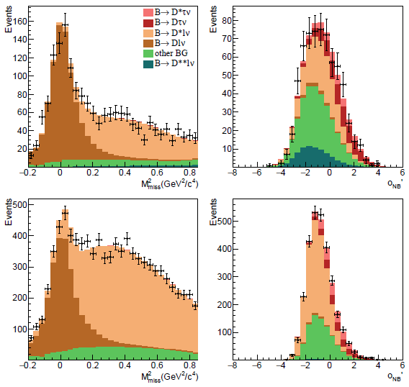
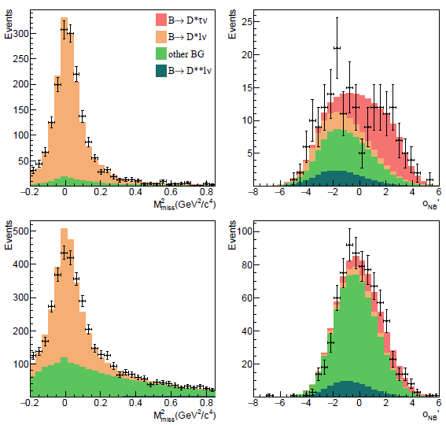
Search for New Physics in B→D^{(*)}τν
M²_{miss} range is split into two regions:
M²_{miss} < 0.85 GeV²/c⁴: populated by events of B→D^{(*)}eν, D^{(*)}μν
M²_{miss} > 0.85 GeV²/c⁴: enriched by B→D^{(*)}τν (τ→eνν, μνν)
To constrain B→D^{(*)}eν, D^{(*)}μν yields M²_{miss} in fitted in the region 1),
while neural-network output O_{NB} is fitted in region 2) .
D⁺ℓ⁻
D*⁺ℓ⁻
D⁰ℓ⁻
D*⁰ℓ⁻

Slide 19
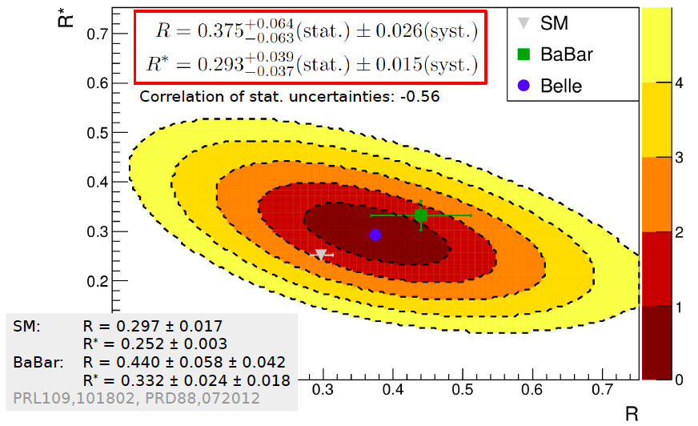
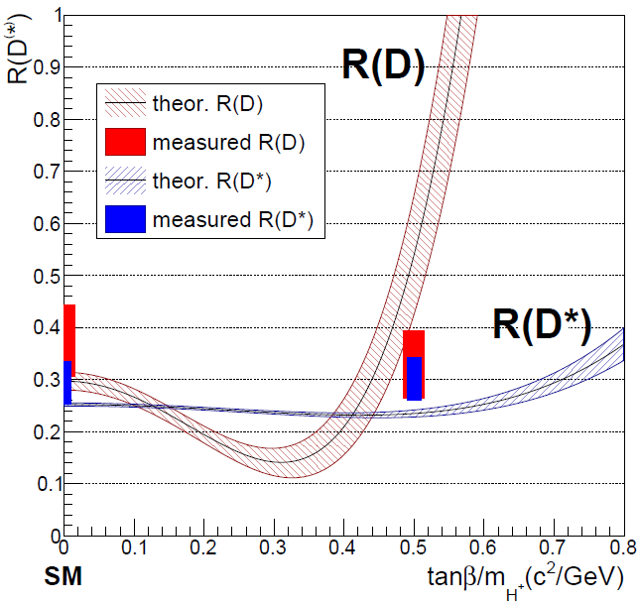
Search for New Physics in B→D^{(*)}τν
The fit was repeated with the PDF generated from 2HDM type II MC
with tanβ/M_{H±} = 0.5 c²/GeV:
R(D) = 0.329 ± 0.060 ± 0.022; R(D)_{2HDM} = 0.590 ± 0.125;
R(D*) = 0.301 ± 0.039 ± 0.015; R(D*)_{2HDM} = 0.241 ± 0.007.
Belle result compatible with 2HDM type II model in the region
around tanβ/M_{H±} = 0.5 c²/GeV

Slide 20
Search for dark photon and dark Higgs boson
Belle: PRL 114, 211801 (2015)
Dark photon A’ and dark Higgs boson h’ are introduced in the Dark Sector Models, with kinetic mixing (ϵ) between A’ and γ_{SM}, and A’ coupling to h’ (α_{D}). One of the promising A’ and h’ production channels at e⁺ e⁻ colliders is Higgs’-strahlung:
e⁺ e⁻ → A’ h’
B. Batell et al., Phys. Rev. D 79, 115008 (2009)
m_{h’} < m_{A’}: h’→A’*A’*
m_{A’} < m_{h’} < 2m_{A’}: h’→A’A’*
m_{h’}> 2m_{A’}: h’→A’A’
At Belle we searched for e⁺ e⁻ → A’ h’[→A’ A’], A’→e⁺e⁻, μ⁺μ⁻, π⁺π⁻
in 10 exclusive final states: 3(e⁺e⁻), 3(μ⁺μ⁻), 3(π⁺π⁻), 2(e⁺e⁻)(μ⁺μ⁻), 2(e⁺e)(π⁺π⁻), 2(μ⁺μ⁻)(e⁺e⁻), 2(μ⁺μ⁻)(π⁺π⁻), 2(π⁺π⁻)(e⁺e⁻), 2(π⁺π⁻)(μ⁺μ⁻), (e⁺e⁻)(μ⁺μ⁻)(π⁺π⁻)
0.1 GeV/c² < m_{A’} < 3.5 GeV/c²
0.2 GeV/c² < m_{h’} < 10.5 GeV/c²
in 3 inclusive final states: 2(e⁺e⁻)X, 2(μ⁺μ⁻)X, (e⁺e⁻)(μ⁺μ⁻)X
1.1 GeV/c² < m_{A’} < 3.5 GeV/c²
2.2 GeV/c² < m_{h’} < 10.5 GeV/c²

Slide 21
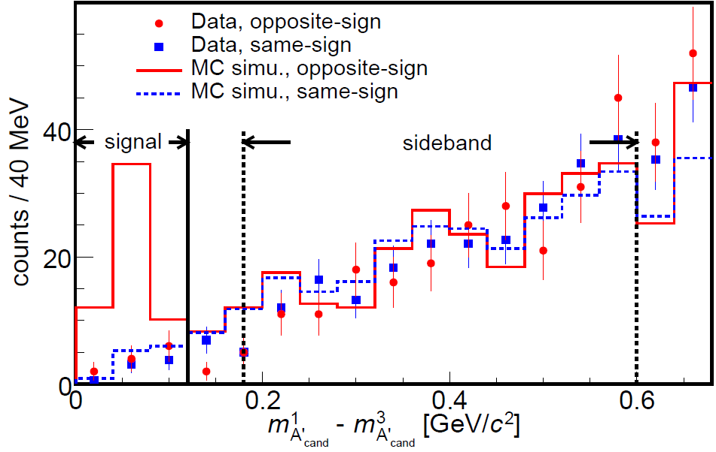
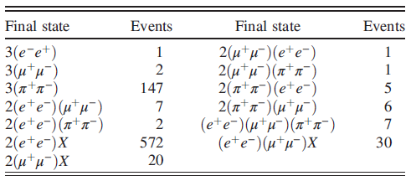

Search for dark photon and dark Higgs boson
Data: 977 fb⁻¹
Selections:
m¹_{A’} > m²_{A’} > m³_{A’}
analysis in bins of m¹_{A’}
divide m¹_{A’} - m³_{A’} into signal and sideband regions
same-sign events were used to evaluate background in the signal region
Number of observed events
Efficiency: (20 ÷ 30)%

Slide 22
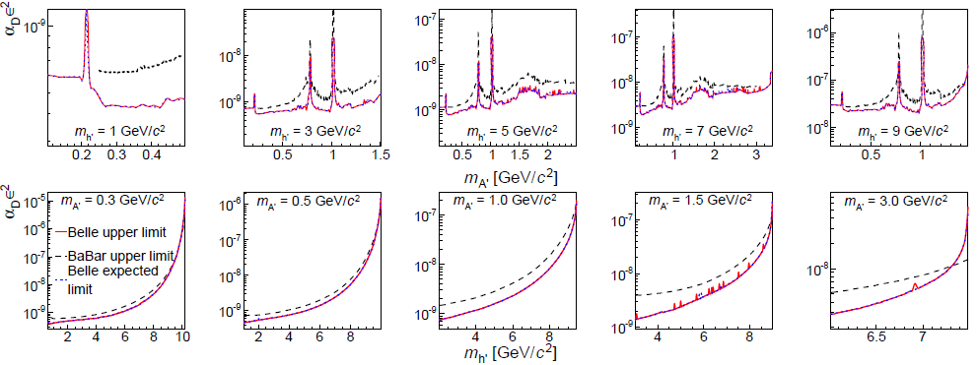
Search for dark photon and dark Higgs boson
90%CL upper limits on the product α_{D} ×ϵ²
BaBar: PRL 108 211801 (2014)
No significant signal is observed

Slide 23
Summary
Cross sections of the reactions e⁺e⁻→ϒ(nS)π⁺π⁻, e⁺e⁻→h_{b}(nP)π⁺π⁻ and e⁺e⁻→ have been measured in the region of ϒ(5S) and ϒ(6S) resonances. Energy behaviour of the σ(e⁺e⁻→ϒ(nS)π⁺π⁻) and σ(e⁺e⁻→h_{b}(nP)π⁺π⁻) is similar. Masses and widths of ϒ(5S,6S) were measured precisely, they agree with the previous measurements.
We found an evidence of ϒ(6S)→Z_{b}[→h_{b}π]π.
BB*/B*B* modes dominate in Z_{b} decays with the branching ratios 83%/71%, Z_{b} properties agree well with B^{(*)}B* molecular structure.
B→D^{(*)}τν have been studied at Belle , our result on R and R* agrees with both SM expectation and BaBar result. It is also consistent with 2HDM type II model in the region around tanβ/M_{H±} = 0.5 c²/GeV
No significant signal was found for dark photon and dark Higgs, 90% CL upper limits on the product α_{D} ×ϵ² were obtained.

