Slide 1
Study of e⁺e⁻ →π⁺π⁻η(γ) using initial-state radiation with BaBar
Evgeny Kozyrev, Evgeny Solodov
Budker Institute of Nuclear Physics SB RAS, Novosibirsk
Novosibirsk State University
1
RC: David Norvil Brown, Vladimir P. Druzhinin, Wolfgang Gradl
BaBar Physics Jamboree, June 1-3, 2016
Notes:
sxXZX

Slide 2
2
Outline
1. Introduction
2. ISR technique and data set
3. The measurement of e⁺e⁻ →π⁺π⁻η(γ) cross section
4. Systematic errors
5. Intermediate states
6. The test of CVC hypothesis
7. J/psi region
8. Summary
Notes:
sxXZX

Slide 3
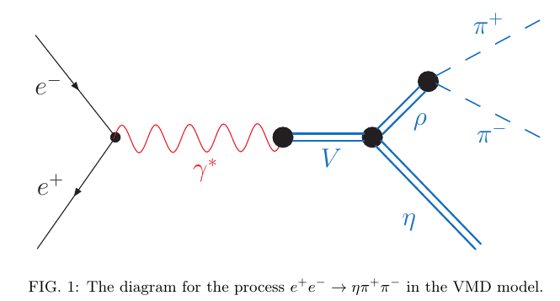
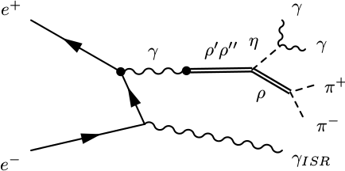
1. Introduction
3
BaBar data allows to perform the precisest measurement of
e⁺e⁻ → π⁺π⁻η cross section.
The measurement
● is firstly sensitive to ρ''(1700) contribution
● allows to test the conservation of vector current (CVC) hypothesis in comparison with spectral functions of τ decays into π⁻π⁰ηντ
● allows to obtain Br(J/ψ→ π⁺π⁻η)
and …
The measurement is based on the initial state radiation (ISR) technique
and includes √s = [1.19:3.5] GeV
arxiv:1412.1971
ρ, ρ', ρ'', ρ'''
The diagram for the e⁺e⁻ → π⁺π⁻η in the VMD model
The diagram for the e⁺e⁻ → π⁺π⁻η(γ) in the VMD model

Slide 4
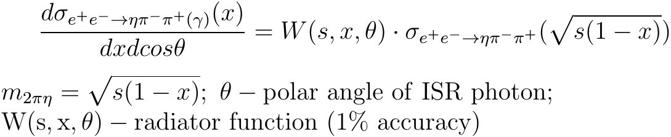
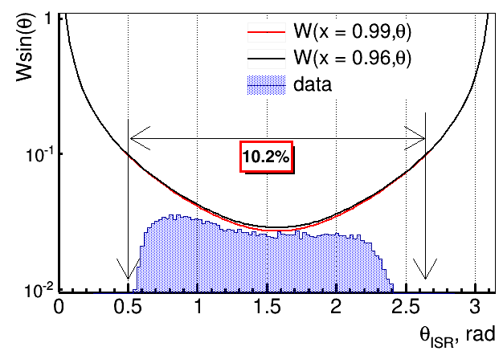
2. ISR technique and data set
4
The cross section e⁺e⁻→hadron+γ can be represented in the factorized form:
in c.m.f.
Data: L = 468 1/fb
Cечение процесса e⁺e⁻→Xγ м.б. представлено в факторизованном виде:
468 fb⁻¹
MC
theory
Born cross section

Slide 5
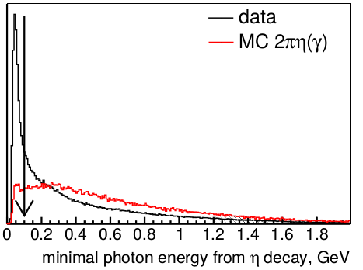
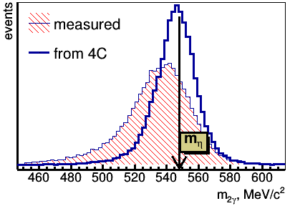
3. e⁺e⁻ →π⁺π⁻η(γ). Event selection.
5
Preliminary selection:
- the presence of a high-energy photon with energy in c.m. frame > 3 GeV
- the existence of at least, two charged
tracks and two additional photons with
energy greater than 100 MeV and invariant
mass in the range [0.4:0.65] GeV/c²
Soft photon background is mainly related to 2π± 2π⁰ ISR process with low energy π⁰ momentum.
Kinematic fit:
4 constraints – energy-momentum
conservation
The idea of signal identification:
To fit two photons invariant mass after 4C reconstruction

Slide 6
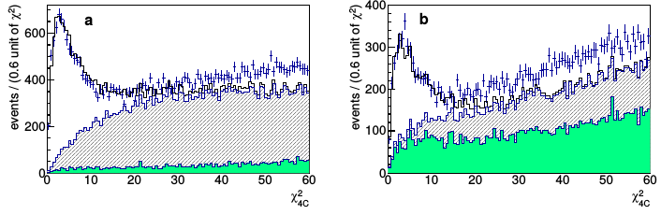
3. e⁺e⁻ →π⁺π⁻η(γ). Event selection.
6
Region I:
m2πη= [1.19:2] GeV/c²
Region II:
m2πη= [2:3.5] GeV/c²
Simulated χ²_{4C} in comparison with data. The filled histogram - non-ISR background, the hatched histogram – ISR background.
► The selection χ²_{4C} < 25 (15) is applied for following study
►Signal yields ~ 9000 events
► Background
ISR NOT ISR e⁺e⁻→qqbar
Peaking bkgr. Not peaking bkgr. Peaking bkgr. Not peaking bkgr.
e⁺e⁻→3πηγ_{ISR} e⁺e⁻ →π⁺π⁻π⁰π⁰γ_{ISR} e⁺e⁻ →π⁺π⁻π⁰η e⁺e⁻ →π⁺π⁻π⁰π⁰
e⁺e⁻→2Kηγ_{ISR} ….. ….. …..
AfkQed
Jetset7.4

Slide 7
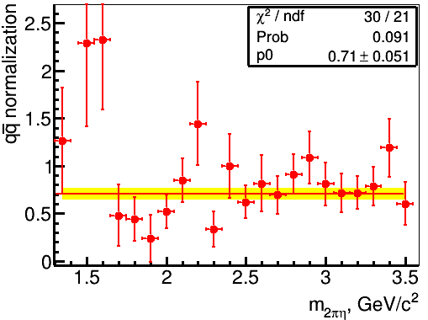
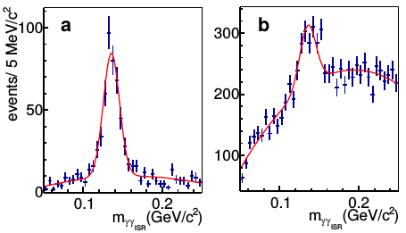
3. e⁺e⁻ →π⁺π⁻η(γ). Event selection.
7
► the ISR backgrounds was normalized according to its known cross sections.
►The NOT ISR background e⁺e⁻→qqbar was normalized by peak of m_{γγISR} near π⁰ because the photon from the π⁰ simulates γ_{ISR} photon.
The qqbar normalization factor in the dependence on m_{2πη}.

Slide 8
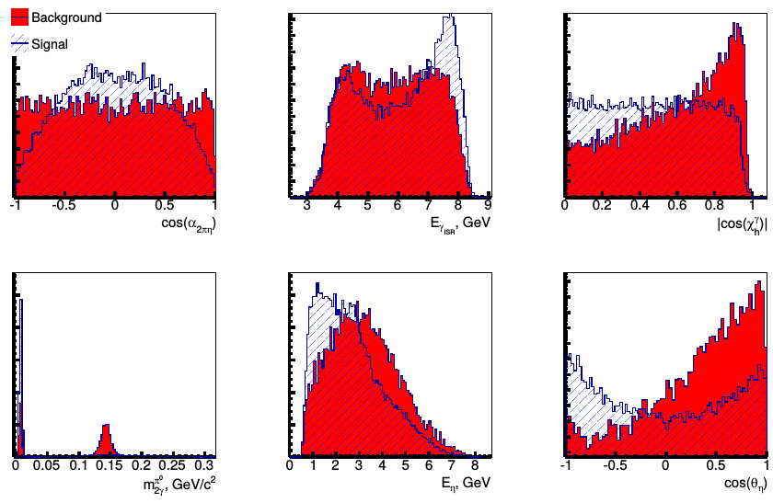
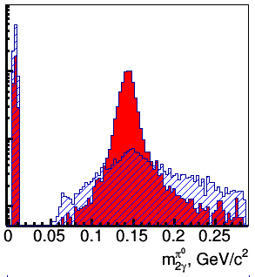
3. e⁺e⁻ →π⁺π⁻η(γ). Event selection.
8
The next parameters are used for additional multivariative discrimination based on Boosted Decision Trees algorithm:
(1)
(1)
(2)
(3)
(4)
(5)
(6)
BDT input variables for m2πη= [1.5:2] GeV/c²: (1) the cosine of the angle between the normal to the π⁺π⁻η plane in the π⁺π⁻η rest frame and the γ_{ISR} direction in the c.m.f., (2) the ISR photon energy, (3) the absolute value of the cosine of the angle between the decay photon momentum in the η rest frame and the η direction in the lab frame, (4) the two-photon invariant mass closest to the π⁰ mass, (5) the energy of the η-meson candidate, (6) the cosine of the angle between the η momentum in the π⁺π⁻η rest frame and the γ_{ISR} direction in the c.m.f.

Slide 9
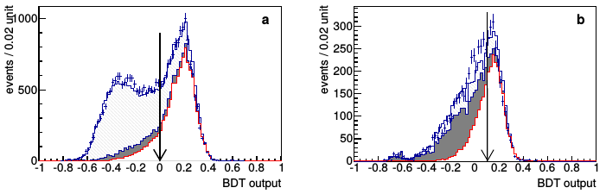
3. e⁺e⁻ →π⁺π⁻η(γ). Event selection.
9
Region I
Region II
The BDT output distribution. The histogram is the sum of MC signal (open area), non-ISR background (filled area), ISR background (hatched area).
► The half of signal MC sample is used for the BDT training and the remaining half - for efficiency calculation
►The classifier is trained in intervals with m2πη= 0.5 GeV/c² width
► BDT response > 0 (0.1) is required which leaves about 85% (63%) of signal events.

Slide 10
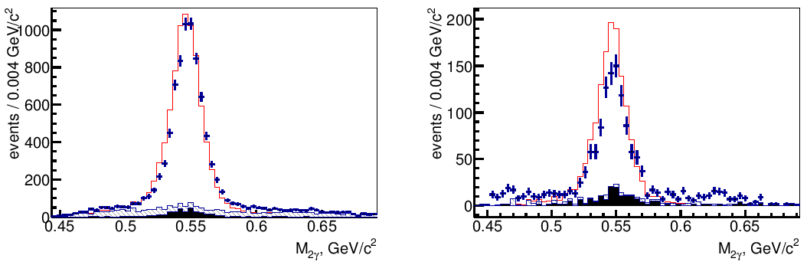
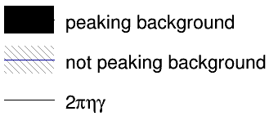
3. e⁺e⁻ →π⁺π⁻η(γ). Event selection.
10
m2πη=
[1.1:2.3]
GeV/c²
m2πη= [2.3:3.5] GeV/c²
The invariant mass of two photons from 4C fit
►The peaking background is bin-by-bin subtracted from data
►The number of signal events is defined by approximation of two photon mass as a sum of signal and background simulated profiles:
m2πη=
[1.3:1.325]
GeV/c²
m2πη=
[1.5:1.525]
GeV/c²
m2πη=
[3.3:3.4]
GeV/c²

Slide 11
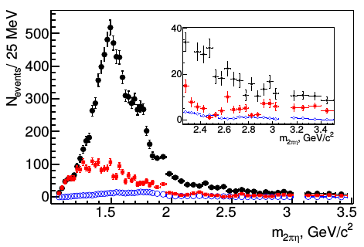
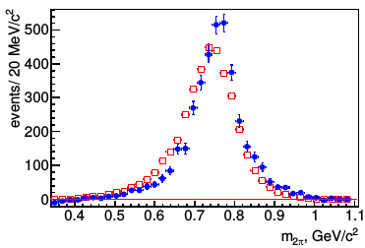
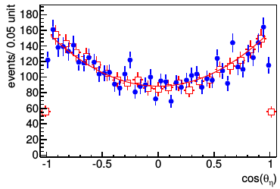
3. e⁺e⁻ →π⁺π⁻η(γ). Event selection.
11
The experimental spectrum in dependence on m2πη = √s. Squares – the background from m_{γγ} approximation. Circles – peaking background.
MC
data
MC
data
Two-pion invariant mass
Cosine of η polar angle in ηπ⁻π⁺ rest frame

Slide 12
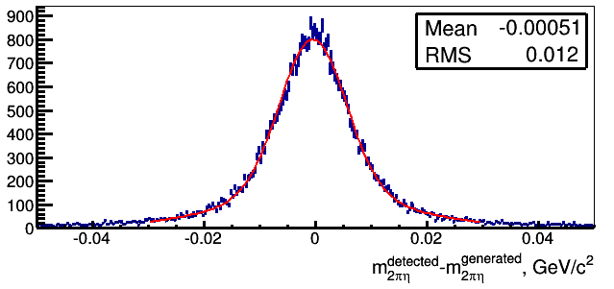
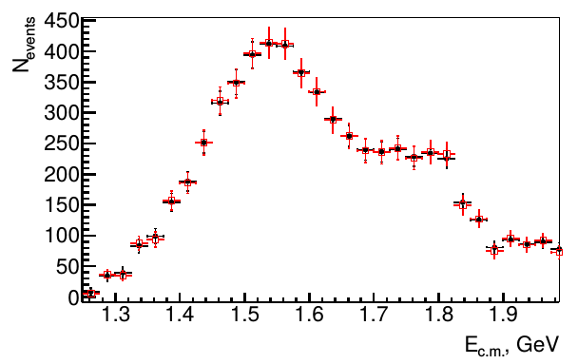

3. e⁺e⁻ →π⁺π⁻η(γ). Unfolding.
12
A(i, i) ≈ 0.82
A(i ± 1, i) ≈ 0.09
The matrix A(i,j) is extracted from the simulation.
Inverting migration matrix A, the true spectrum dN⁰/dm is found.
Similar features near nucleon-antinucleon threshold was found in other channels e⁺e⁻ → 6π, ωπ⁺π⁻π⁰, 2(π⁺ π⁻)π⁰.
The m_{π+π-η} spectrum before (circles) and after (squares) unfolding.

Slide 13

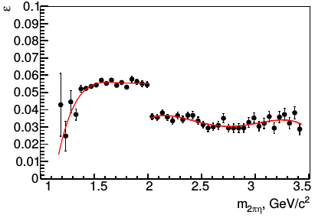


4. e⁺e⁻ →π⁺π⁻η. Detection efficiency and systematic errors.
13
ISR photon is simulated in the region [20○:160○] MeV/c² in c.m.f.
The MC efficiency must be corrected to account for data-MC difference in detector response
The MC efficiency must be corrected to account for data-MC difference in detector response
1. due to data-MC difference the χ_{4C} profile
2. due to η reconstruction (from e⁺e⁻ →π⁺π⁻π⁰γ)
3. track reconstruction (from e⁺e⁻ →2π⁺2π⁻γ)
4. ISR photon reconstruction (from e⁺e⁻ →μ⁺μ⁻γ)
The detection efficiency according to MC simulation

Slide 14
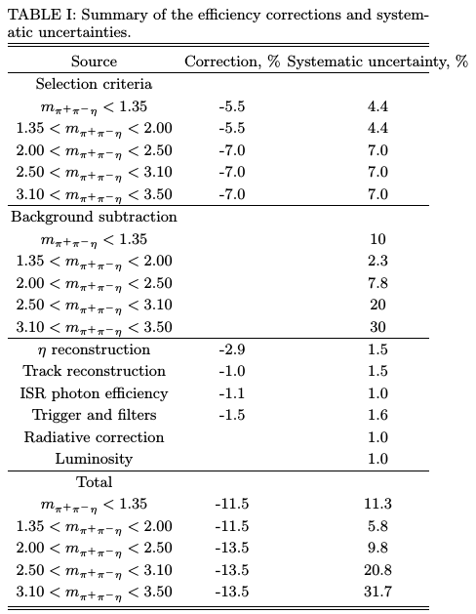
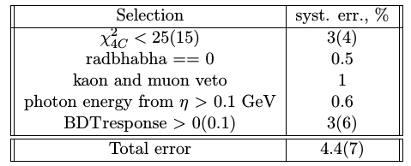
4. e⁺e⁻ →π⁺π⁻η. Detection efficiency and systematic errors.
14
● Uncertainty in normalization of subtracted peaking background
● Signal and backgr. profiles uncertainties
(estimated by the variation of the profiles)
● The uncertainty in m_{γγ} fit procedure
(estimated by toy-MC as 0.3 %)
The main source of uncertainty is related with peaking background normalization and “BDT response” selection

Slide 15
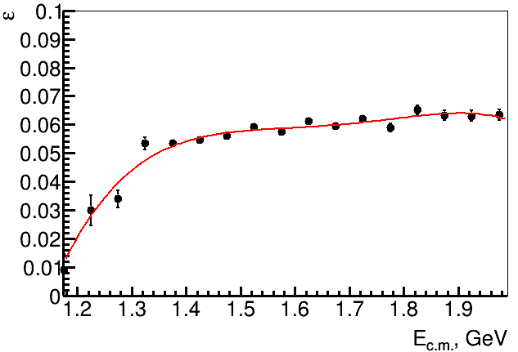
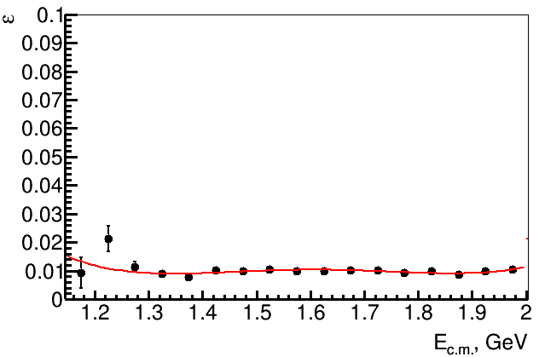
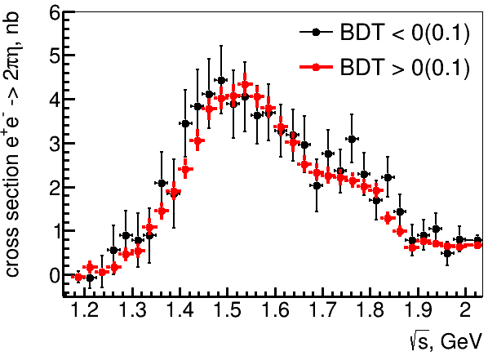
4. e⁺e⁻ →π⁺π⁻η. Detection efficiency and systematic errors.
15
BDT > 0
BDT < 0

Slide 16
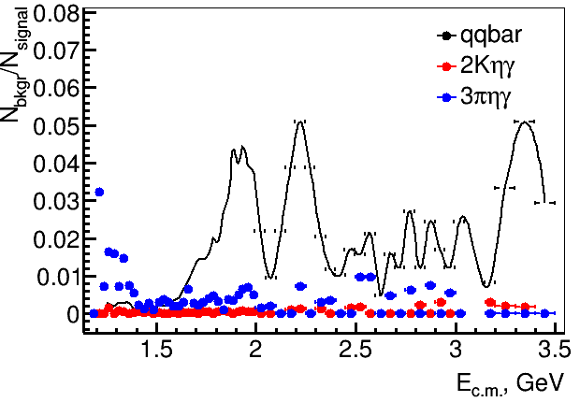
4. e⁺e⁻ →π⁺π⁻η. Systematic uncertainty from peaking background subtraction.
16
● Backgr. e⁺e⁻→2Kηγ_{ISR}, e⁺e⁻→3πηγ_{ISR} is relatively small and well normalized according to its cross sections.
● The main contribution to peaking background is coming from e⁺e⁻ →qqbar →π⁺π⁻π⁰η. In this subtraction, we assume that JETSET reproduces correctly the fraction of π⁺π⁻π⁰η events (50% according to JETSET).
● To estimate a systematic uncertainty due to this assumption, we increase the π⁺π⁻π⁰η fraction up to 100%.

Slide 17
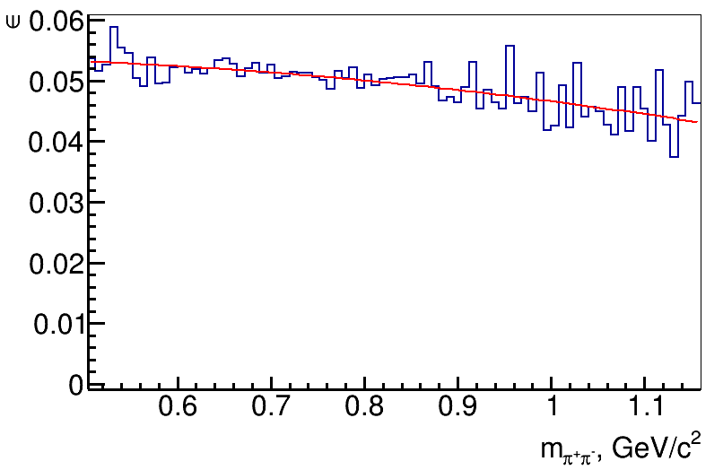
4. e⁺e⁻ →π⁺π⁻η. Detection efficiency and model uncertainty.
17
MC
data
We use MC simulation based on the e⁺e⁻ →ρη→π⁺π⁻η mechanism
The observed difference between data and simulated π⁺π⁻ invariant mass distributions may be explained by the contribution of other intermediate states, for example ηρ(1450)
Two-pion invariant mass

Slide 18
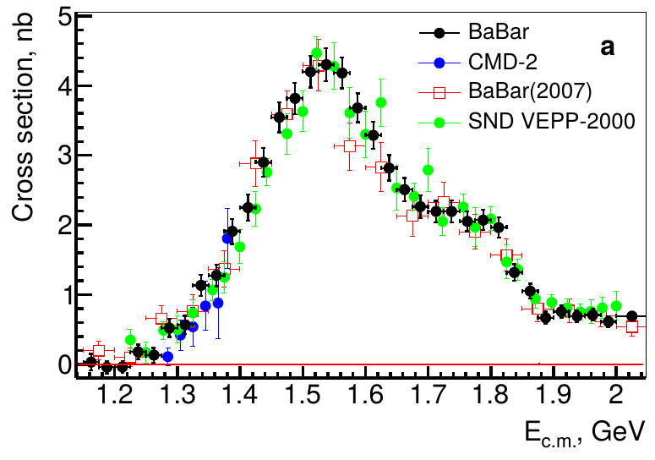

5. e⁺e⁻ →π⁺π⁻η. Cross section.
18
We explain as
ρ'' and ρ'''
contributions
The cross section of the process e⁺e⁻ →π⁺π⁻η as a function of m2πη = √s

Slide 19
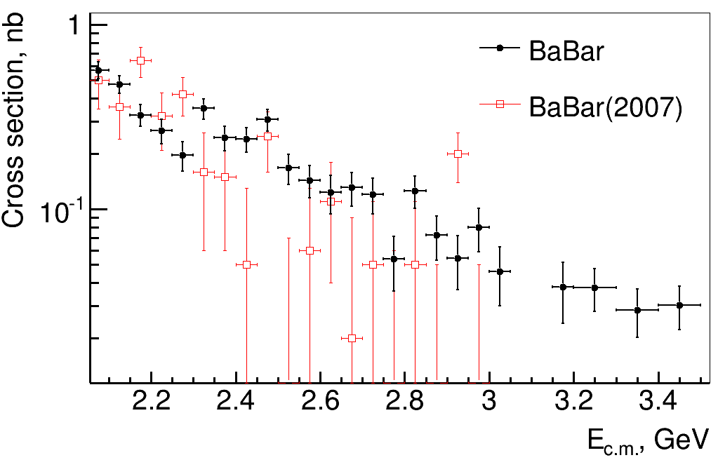
5. e⁺e⁻ →π⁺π⁻η. Cross section.
19
The cross section of the process e⁺e⁻ →π⁺π⁻η as a function of m2πη = √s

Slide 20
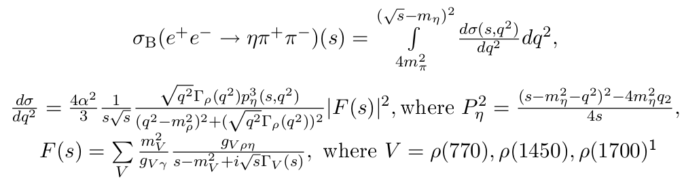

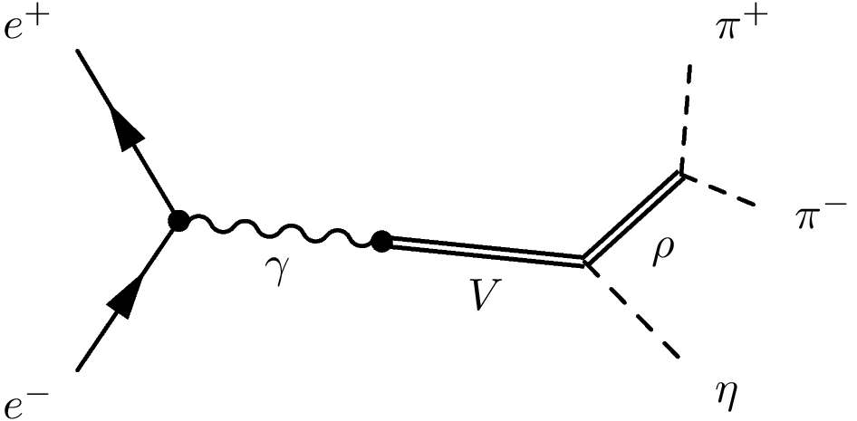
5. e⁺e⁻ →π⁺π⁻η(γ). The energy dependence of cross section.
20
,….
MV, ГV, gV – float parameters
The mass and width of the ρ(770) resonance are
fixed at their nominal values

Slide 21
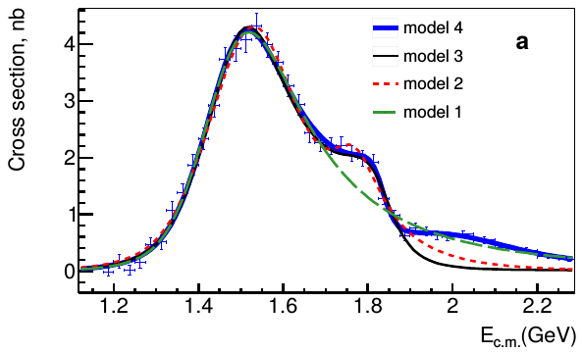
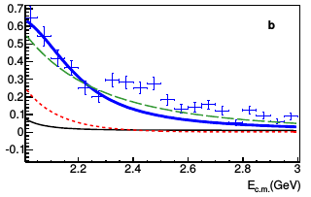
5. e⁺e⁻ →π⁺π⁻η(γ). The energy dependence of cross section.
21
b
Obtained model doesn't describe data above 2.2 GeV
● The fit 1 with ρ and ρ'(1450) has been done up to √s = 1.9 GeV
● The fit 2 and 3 with ρ, ρ'(1450) and ρ''(1700) has been done up to √s = 1.9 GeV
● The fit 4 with ρ, ρ'(1450), ρ''(1700) and ρ''' has been done up to √s = 2.2 GeV

Slide 22
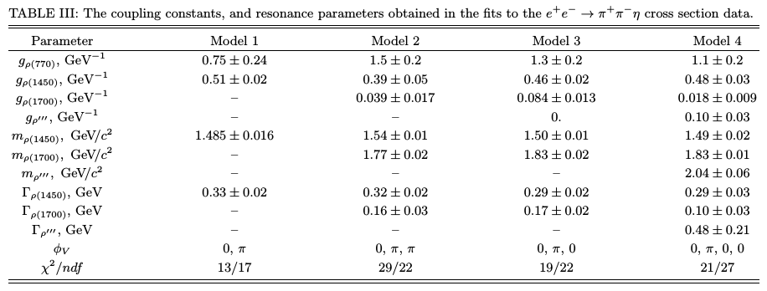
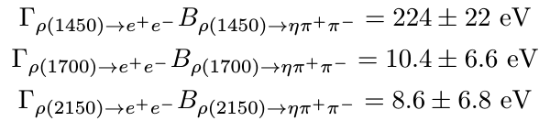

5. e⁺e⁻ →π⁺π⁻η(γ). The energy dependence of cross section.
22
Fit parameters obtained
The obtained parameters with model 3:
The coupling constant gρ(770) = gρρη/gργ can be estimated using data on the partial widths for the decays ρ(770)→ηγ

Slide 23
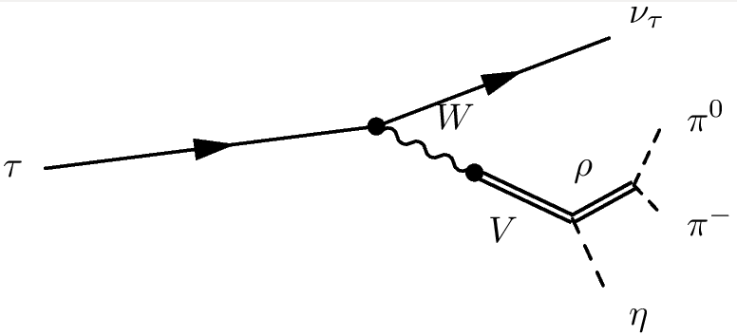


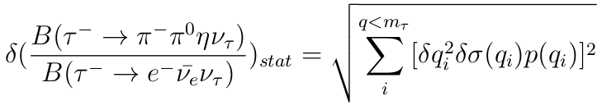
6. CVC test.
23
B^{direct Belle 2009}(τ→ππηντ )=
= 0.135 ± 0.003 ± 0.007 %
B^{CVC}(τ→ππηντ )= 0.1821 ± 0.0038 stat ± 0.0133 syst ± 0.0011 model %
= 0.182 ± 0.014 %
►Partially the difference can be explained by the correction due to vacuum polarization in photon propagator |1+П|² ~ 1.04.
► Need isospin corrections

Slide 24
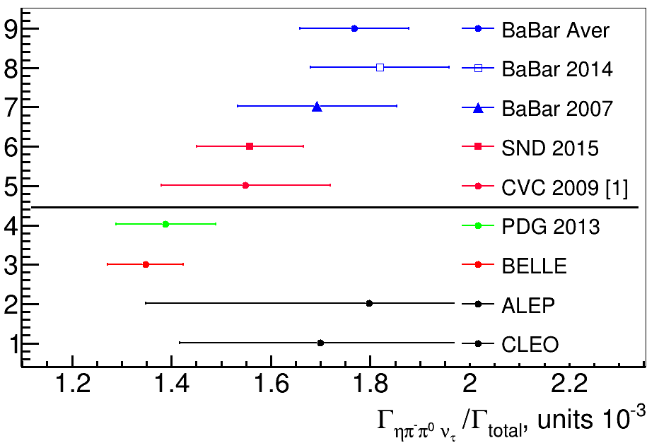
6. CVC test.
24
CVC
this work
direct
CVC 2009 – [1] JETP Letters, Vol. 89, № 9, pp. 429-431 (2009)

Slide 25
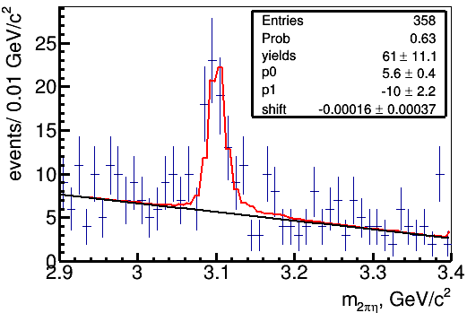



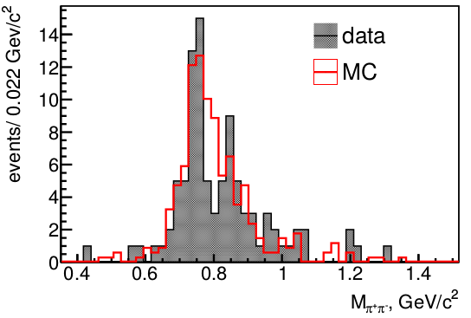
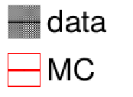

7. e⁺e⁻ →π⁺π⁻η(γ). J/ψ – region.
25
The J/ψ region is approximated using a sum of simulated signal and linear background profiles
Using table value of the J/ψ electron
width:
ρη and ωη interference
It deviates from PDG value of J/ψ→ρη decay
due to comparable contribution of ωη intermediate state

Slide 26
Plans:
26
1. continue the active interaction with RC (any questions and comments are welcome).
2. perform several tests/checks of systematic uncertainties and finalize documentation preparation (not more in 2 weeks)
3. finalize all needed steps of BaBar paper preparation in 2016 y.

Slide 27
Conclusion
27
1. The measurement of the cross section e⁺e⁻ → π⁺π⁻η at √s = [1.1:3.5] GeV has been done. It is the most precise measurement today.
2. The data demonstartes the contribution at least four ρ-like states: ρ(770), ρ'(1450), ρ''(1700), ρ'''.
3. The branching fraction B(τ→ππην_{τ} ) = 0.182 ± 0.014 % has been calculated using CVC hypothesis.
is-isr-15/01
Journal draft: BAD 2655
Supporting document: BAD 2651
Thank you!

